Slide 1
COMS W4118
Operating Systems I

Slide 2
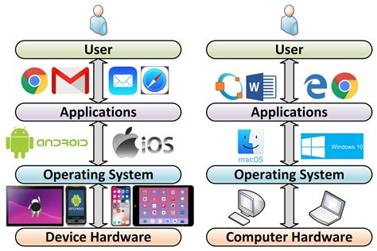
Notes:
Os between apps and hardware

Slide 3
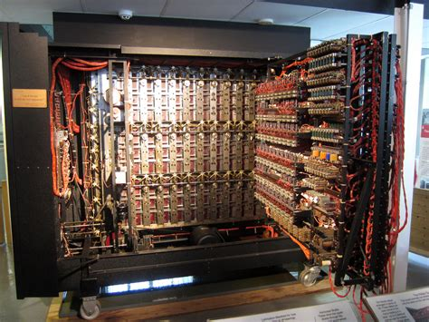
Notes:
Enigma, early computer program by plugboard

Slide 4
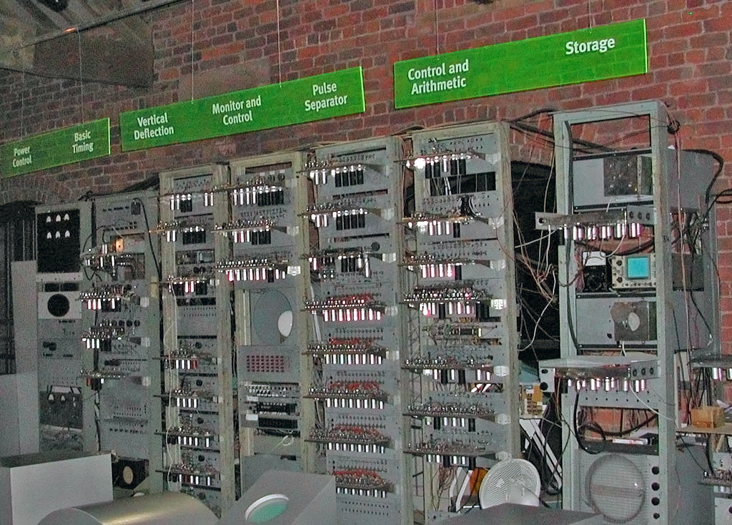
Notes:
Manchester Baby – first stored program computer

Slide 5
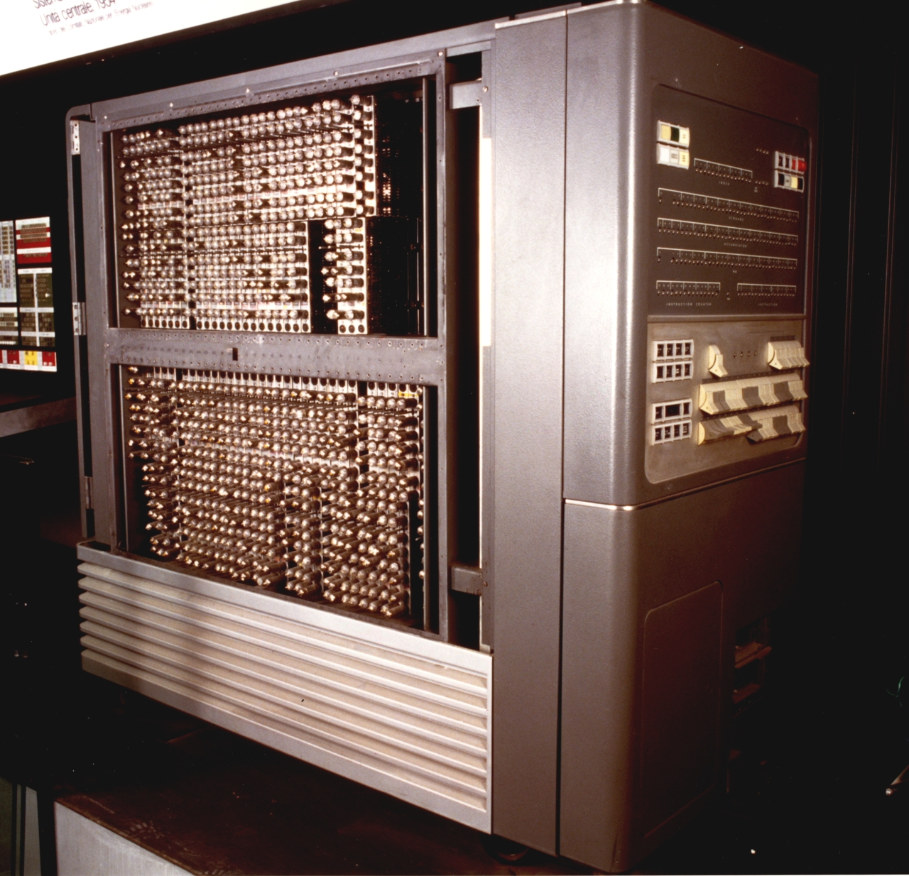
https://youtu.be/mwFWMM9APLs?si=3HDv906LZQzNj8ii&t=284
Notes:
IBM 704 – first computer on which an OS was installed (one off), computer introduced by IBM in 1954

Slide 6
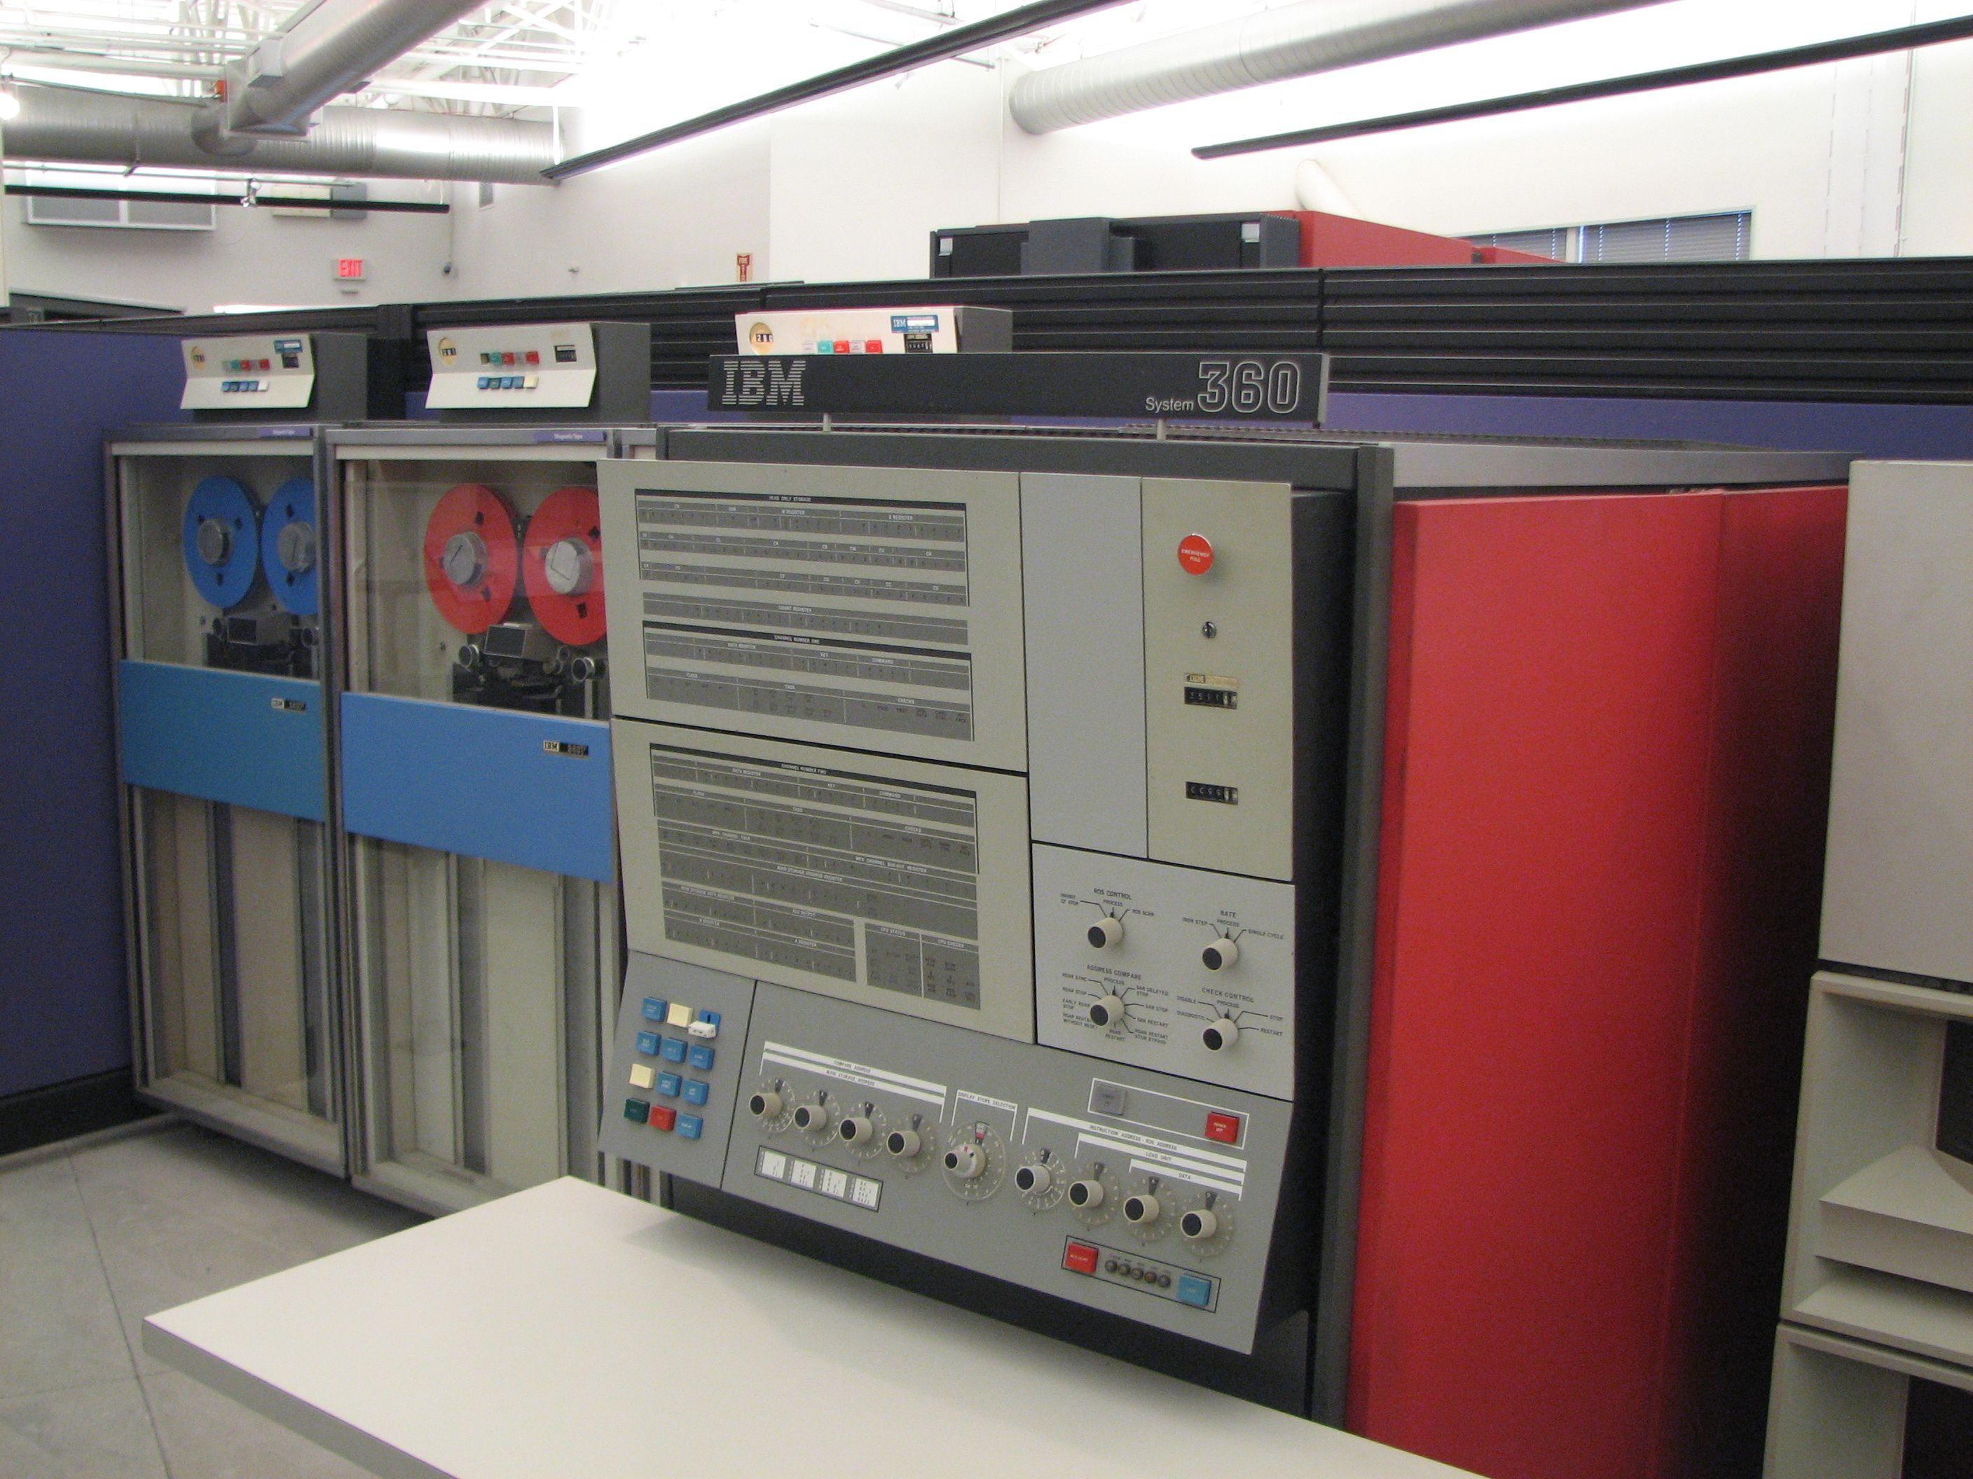
Notes:
IBM system/360 real OS, shipped 1965

Slide 7
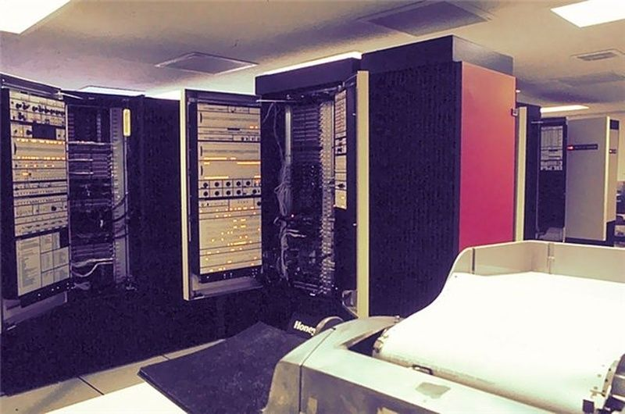
Notes:
GE 645 – computer that ran Multics, one installed at MIT in 1967

Slide 8
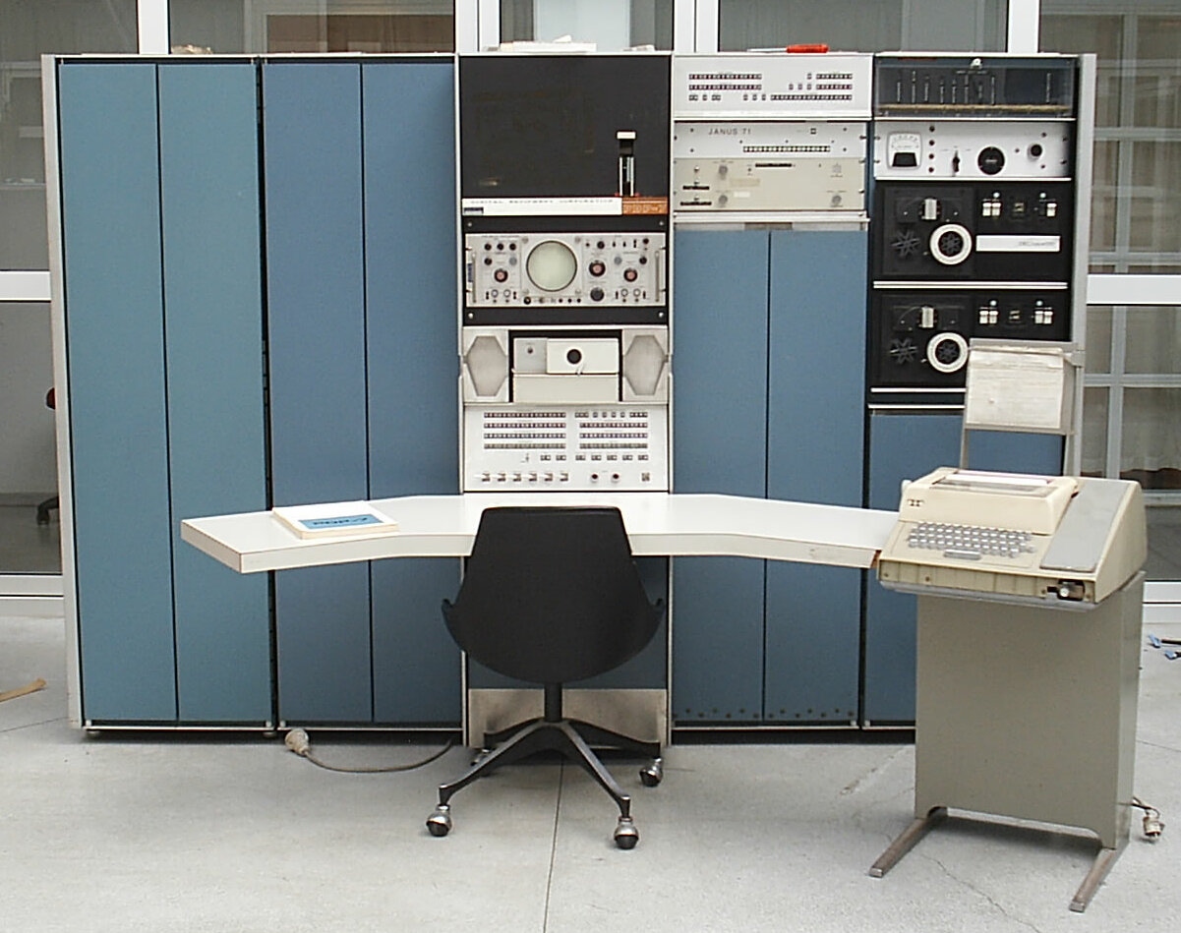
Notes:
PDP-7 computer on which unix was first designed to run, mini-computer, shipped in 1965, $72K.

Slide 9
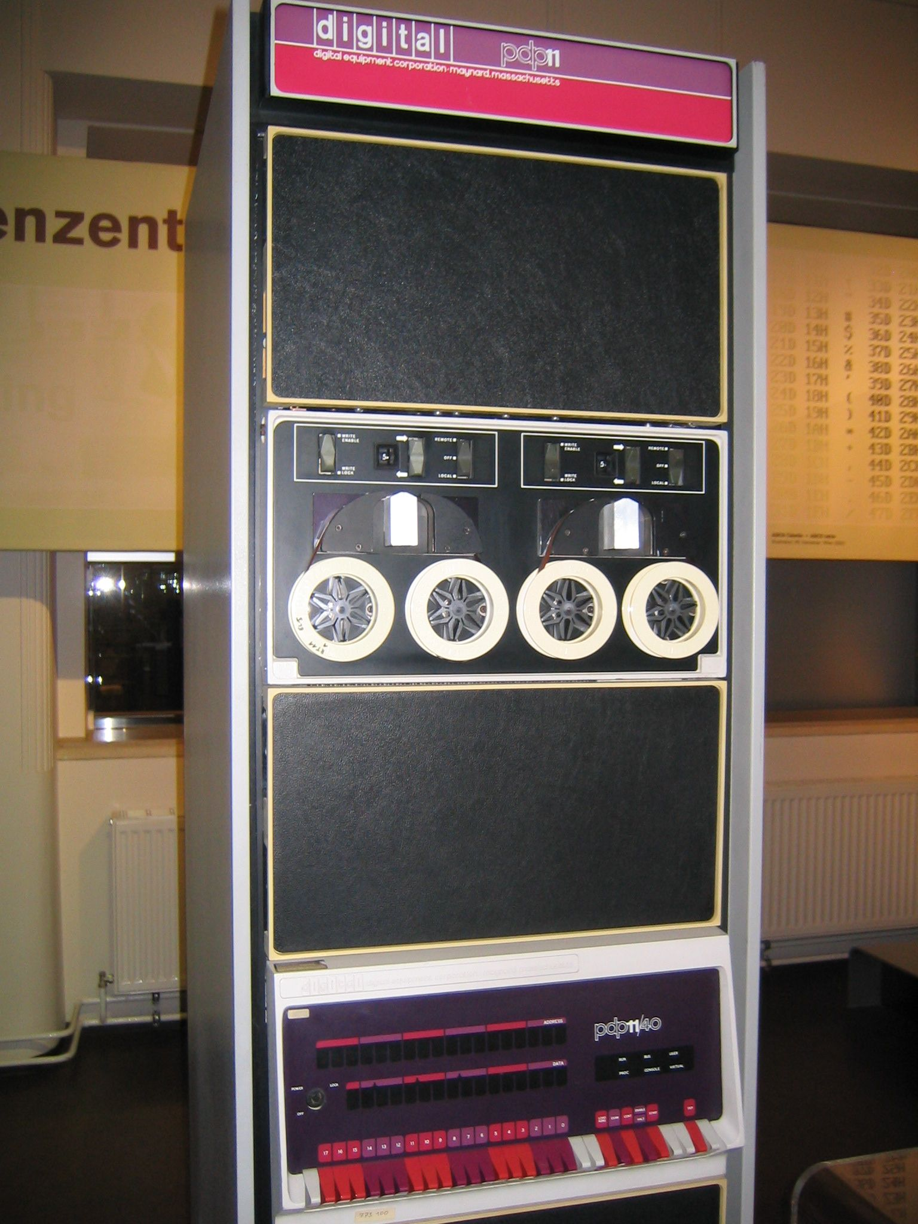
Notes:
PDP-11, first computer to run BSD, 1BSD was add on to Unix V6, distributed in 1978

Slide 10
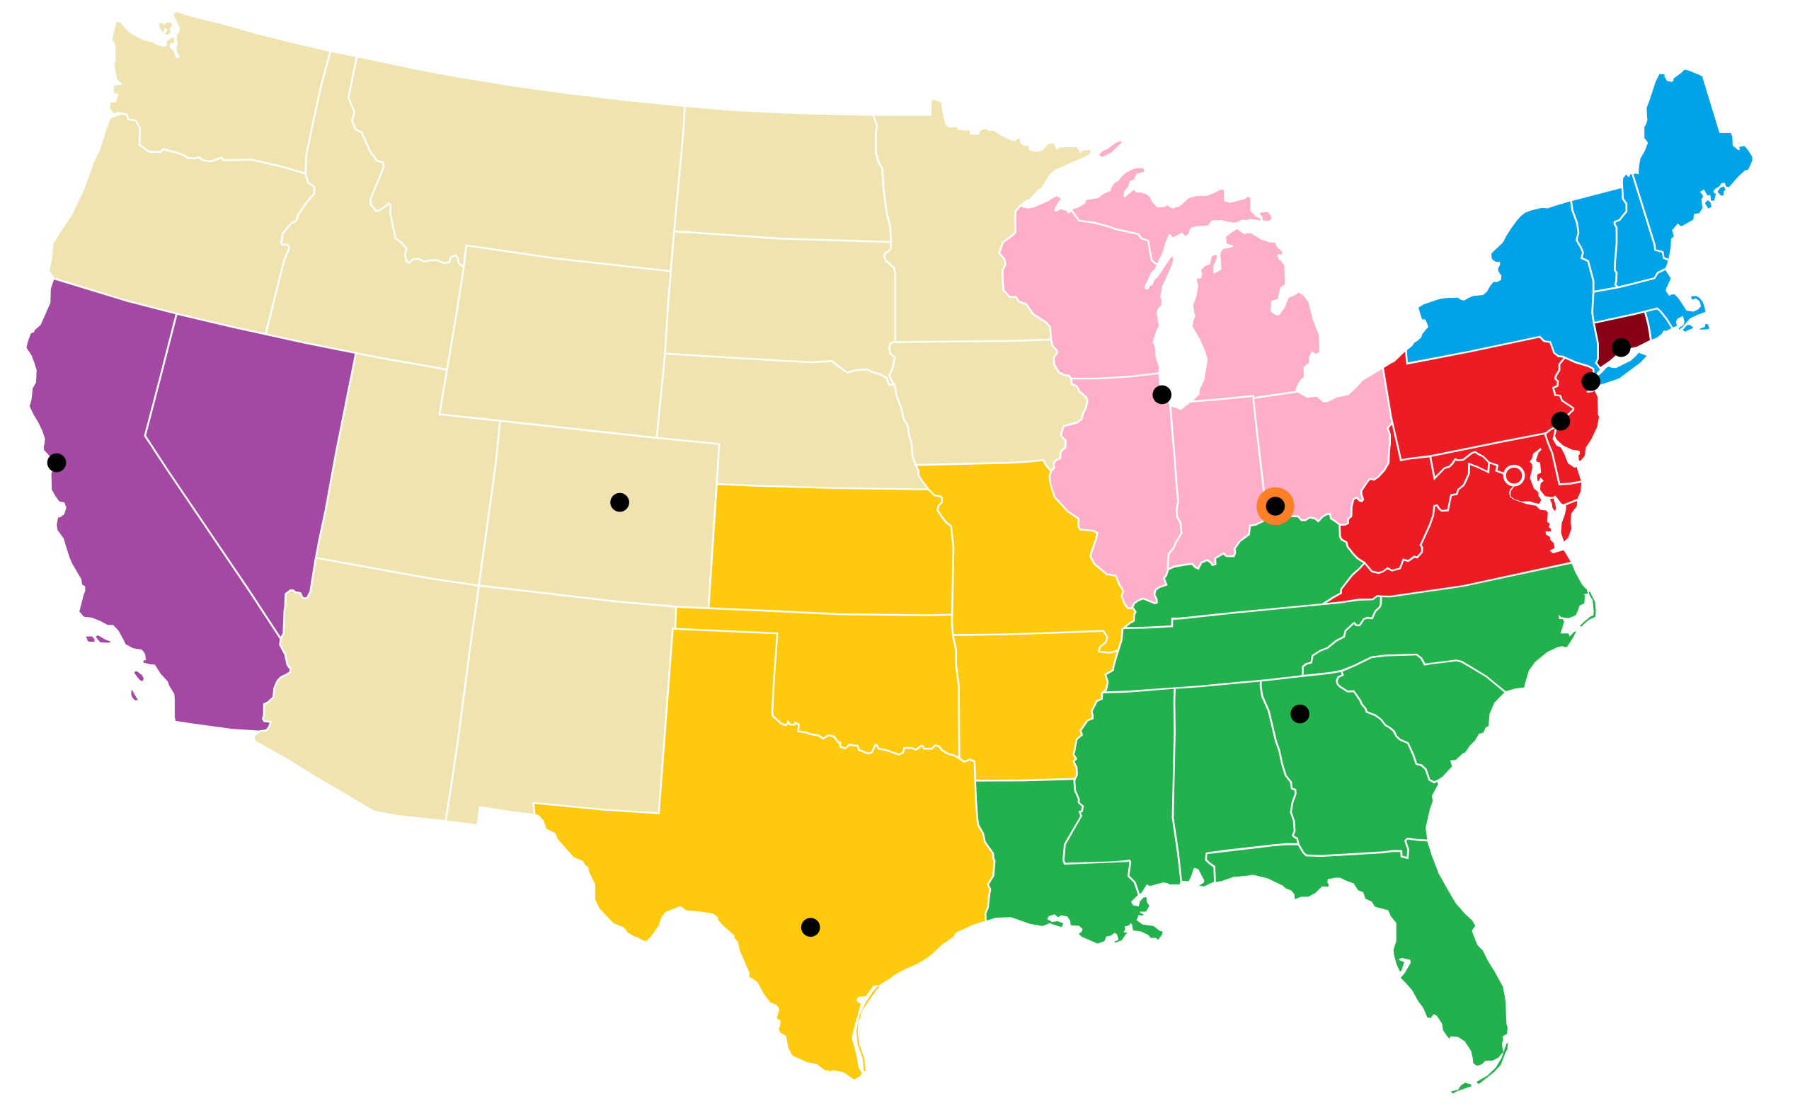
Notes:
ATT break up – ATT could enter computer business, commercialize unix

Slide 11
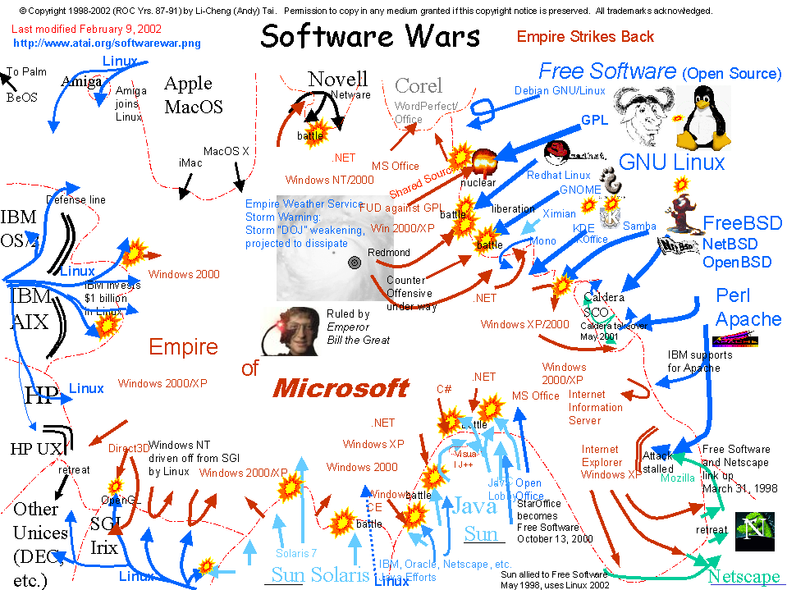
Notes:
UNIX wars in 1990s to standardize UNIX, ATT, Sun, Dec, HP, IBM, OSF, lawsuits, etc.

Slide 12

Notes:
Linux – clean slate, GPL in 1992 for v.99 for x86 (MINIX was also x86 but not open source for commercial use)

